Slide 1
Pivotal Cloud Foundry
Workshop Wrap-up
Pivotal and Perficient
April 2018

Slide 2
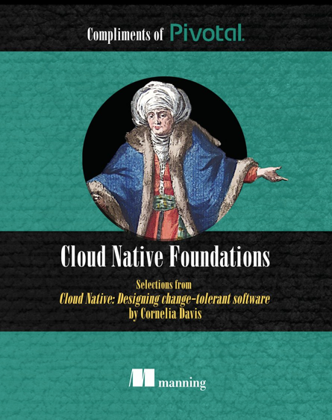
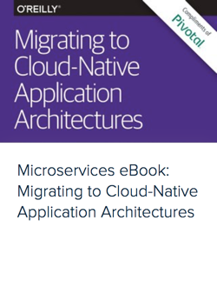
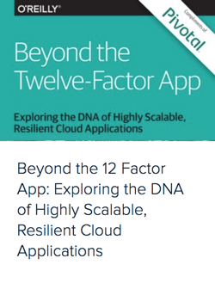
Pivotal eBooks
Suggestion: - Cloud Native Foundations - Migrating to CNA Architectures - Beyond the 12-Factor App - Cloud Foundry - the CN Platform - ... Download free eBooks at: https://content.pivotal.io/ebooks

Slide 3
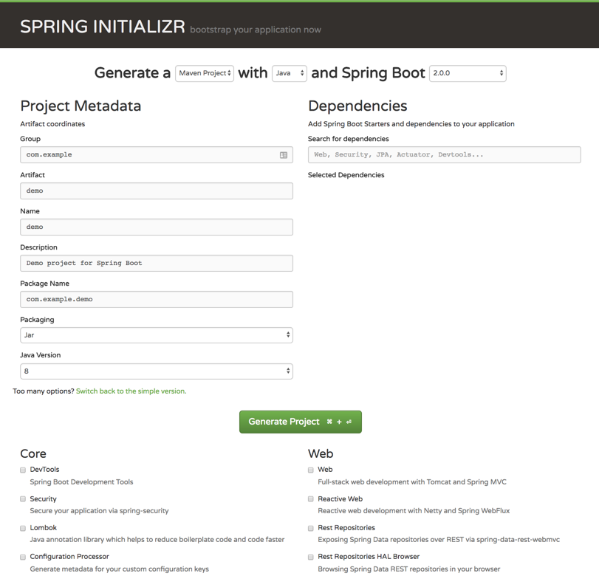
Spring Initializr
Build apps quickly with Spring Starter
http://start.spring.io

Slide 4
Resources
Pivotal home – pivotal.io
Pivotal Cloud Foundry Platform – pivotal.io/platform
Perficient home - www.perficient.com
Perficient services - www.perficient.com/services
Perficient Pivotal Partnership - https://www.perficient.com/partners/pivotal
Pivotal eBooks – pivotal.io/ebooks
Migrating to Cloud-Native Application Architectures - http://goo.gl/i0wwV8
The Cloud Native Journey, by Duncan Winn - http://goo.gl/Z3XLm7
Leading Enterprise Platform powered by Cloud Foundry - http://goo.gl/XfMp8h
The Cloud Native Journey Webinar Series - http://goo.gl/BOkxxj
Customer stories - https://www.youtube.com/watch?v=5q-ntJOKYA4
Pivotal and Perficient

Slide 5
Evaluations
https://goo.gl/forms/dFdQIXxYTpsZghKe2
Please fill out

Slide 6
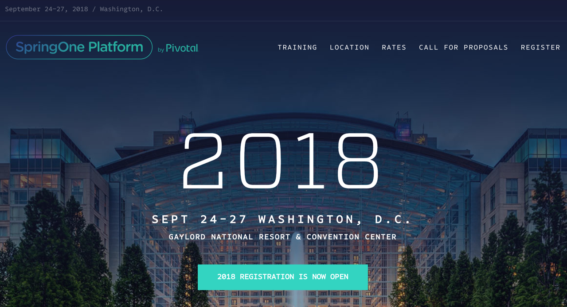
https://springoneplatform.io/

Slide 7

Evaluations - PLEASE fill out - Note link in Readme.md

Slide 8
Q&A, Comments, Suggestions

Slide 9
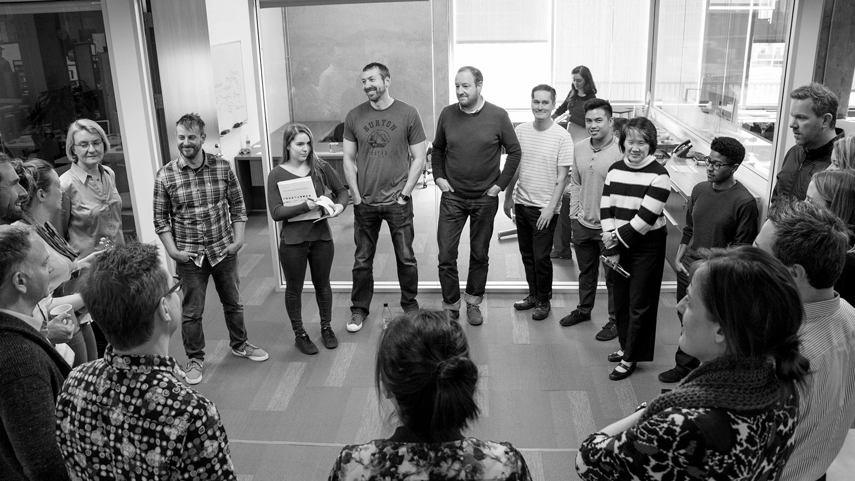
Transforming How The World Builds Software
© Copyright 2018 Pivotal Software, Inc. All rights Reserved.

